Slide 1
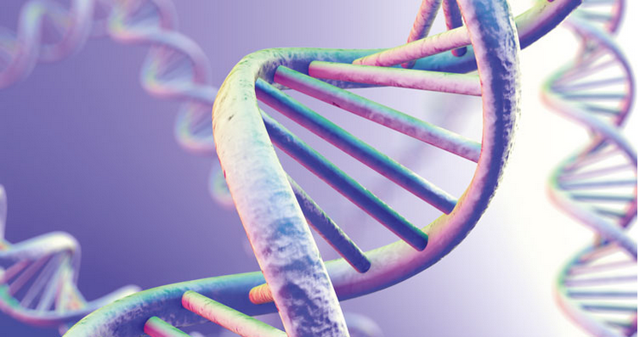
Next-generation Sequencing (NGS)
Jyoti Kataria
Bioinformatics Analyst

Slide 2
Flow
History of sequencing
The First , the Second and the Third Generation of sequencing
Illumina sequencing
FASTQ files
Quality Control of the FASTQ files
Pre-processing

Slide 3
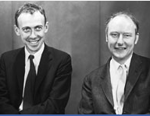
Let’s get back in time!
1953 – Structure of the DNA
1962 – Nobel Prize in Medicine
1965 – The first tRNA
1986 – Robert Holley Nobel Prize
Without minimizing the pleasure of receiving awards and prizes, I think it is true that the greatest satisfaction for a scientist comes from carrying a major piece of research to a successful conclusion” (Holley, 1968)
James Watson and Francis Crick

Slide 4
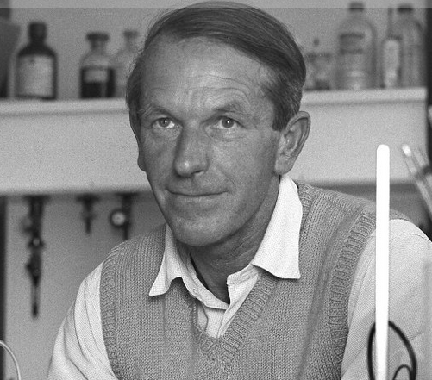
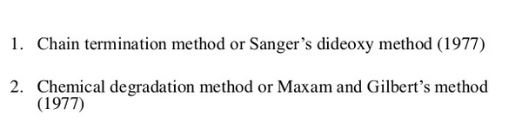
Sequencing Breakthrough : The first generation
1958 – Insulin
1980 – Sequencing
Nobel Prize in Chemistry
Scientific research is one of the most exciting and rewarding of occupations. It is like a voyage of discovery into unknown lands, seeking not for new territory but for new knowledge. It should appeal to those with a good sense of adventure.
Frederick Sanger’s speech at the Nobel Banquet, December 10, 1980

Slide 5
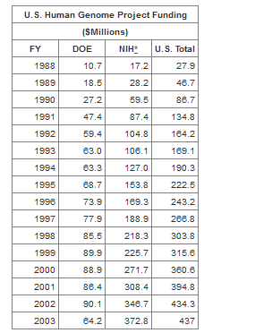
The Human Genome Project (1990-2003)
Identify all the approximately 20,000-25,000 genes in
human DNA
Determine the sequences of the 3 billion
chemical base pairs that make up human
DNA
Store this information in databases
Improve tools for data analysis
https://web.ornl.gov/sci/techresources/Human_Genome/project/index.shtml

Slide 6
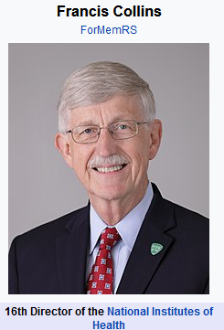
The Human Genome Project (1990-2003)
“The genome could be thought of in terms of a book with multiple uses: "It's a history book - a narrative of the journey of our species through time. It's a shop manual, with an incredibly detailed blueprint for building every human cell. And it's a transformative textbook of medicine, with insights that will give health care providers immense new powers to treat, prevent and cure disease."

Slide 7
Pyrosequencing : The second generation
Generation of million of reads in parallel
Speed of the sequencing process
Low cost of sequencing
$500 per 1000 bases
$0.50 per 1000 bases for next generation sequencing
Detect sequencing output w/o electrophoresis
Roche/454 launched in 2005, Ion Torrent
Illumina/Solexa in 2006
ABI/SOLiD in 2007

Slide 8
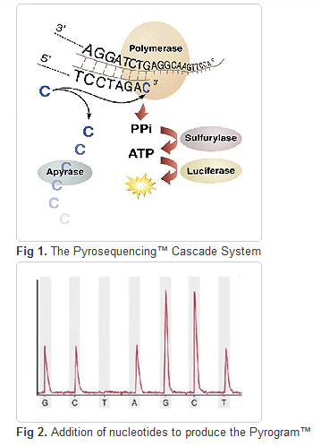
Pyrosequencing : The second generation
No need of heavily modified dNTPs
Real time observation w/o gel electrophoresis

Slide 9
Illumina :The second generation
Major player in the second generation sequencing domain
Principle : Bridge amplification
Error Rate : <0.1% - 10%
More than 90% of the world's sequencing data
Ultra-high throughput

Slide 10
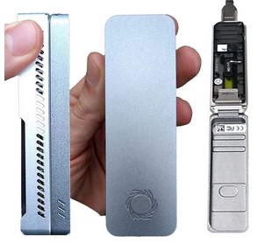
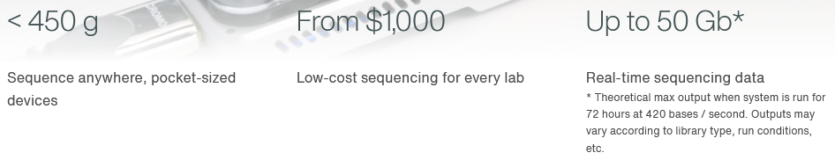
Oxford Nanopore : The third generation
Minion
https://nanoporetech.com/how-it-works

Slide 11
SMRT PacBio : The third generation
https://www.youtube.com/watch?v=_lD8JyAbwEo&ab_channel=PacBio

Slide 12
Recap :
First Generation :
1. Sanger Sequencing
2. Maxam-Gilbert Degradation
Second Generation :
1. 454 Roche Pyrosequencing
2. Ion Torrent
3. Illumina
4. ABI Solid
Third Generation :
1. Oxford Nanopore
2. PacBio SMRT

Slide 13
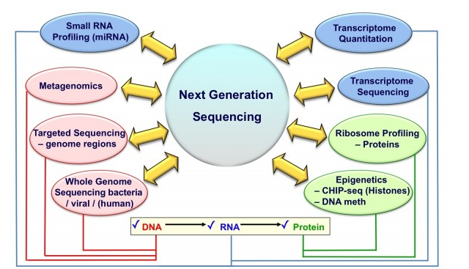
Applications V.I.S.
https://www.europeanpharmaceuticalreview.com/article/10409/dna-sequencing-technologies-and-emerging-applications-in-drug-discovery/

Slide 14
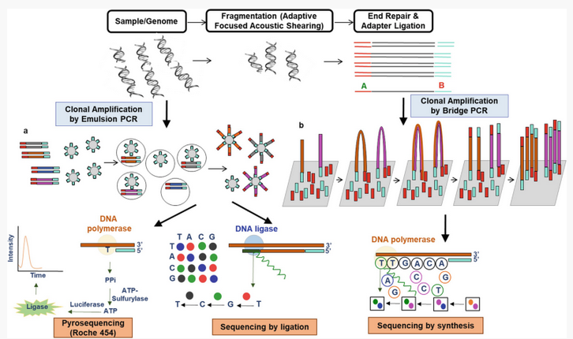
Basic Steps in NGS platforms
https://link.springer.com/chapter/10.1007/978-981-13-8844-6_15

Slide 15
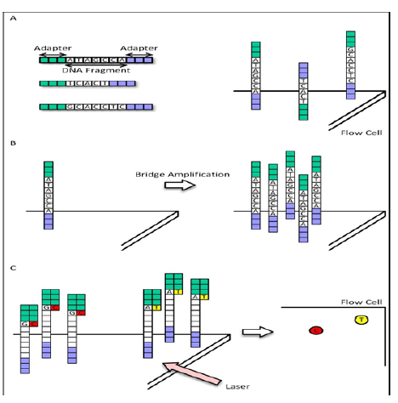
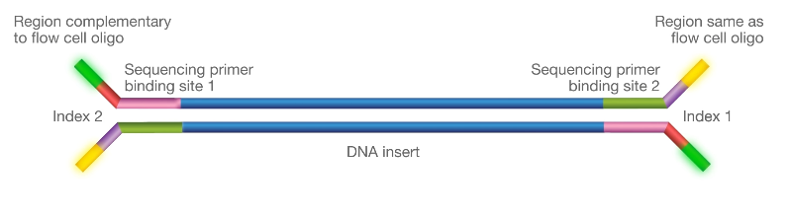
Illumina Sequencing
Adapter Sequence
Adapter Sequence
www.youtube.com/watch?v=womKfikWlxM

Slide 16
How to pool samples ? This is how we reduce the cost!!!!!! Multiplexing/Pooling
>> Allows multiple samples to be processed simultaneously, saving cost and time.
>> Multiplexing requires adding a barcode (index) to samples so they can be identified after sequencing.
>>Additional indexes, called unique molecular identifiers (UMIs) can be used to identify specific molecules within a sample.
>> Using adapters with UMIs in hybridization capture allow you to remove PCR duplicates for better quantitation or use multiple duplicate reads for in silico error correction to increase accuracy by reducing the rate of false positives.

Slide 17
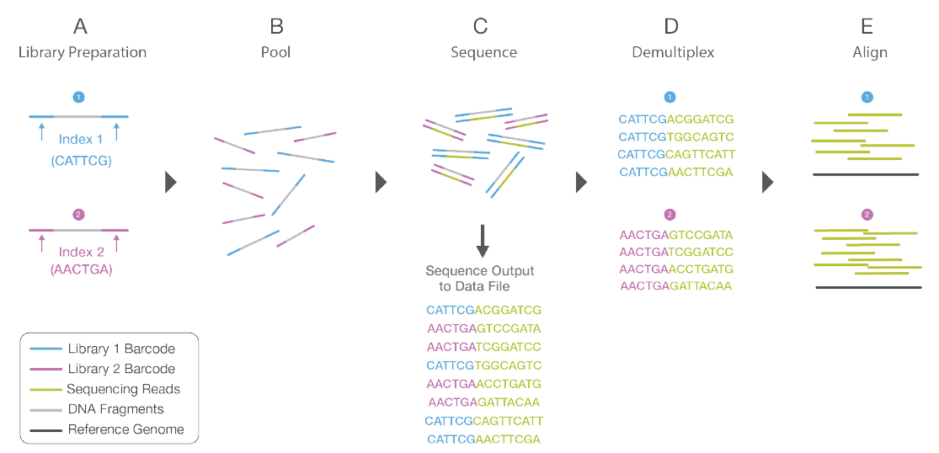

Slide 18

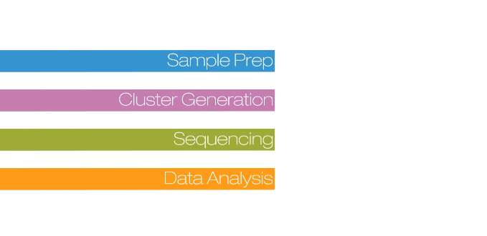
Illumina NGS Technology

Slide 19
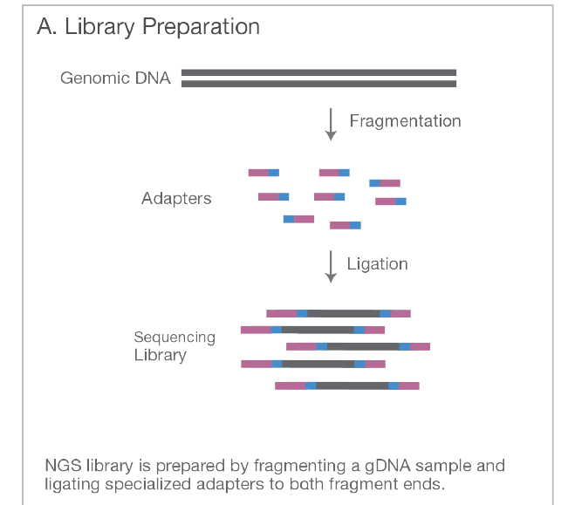

Slide 20
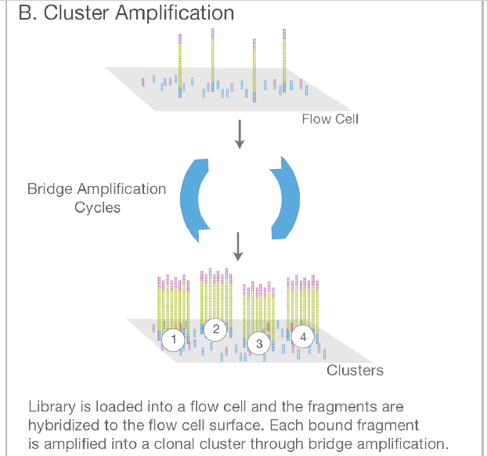

Slide 21
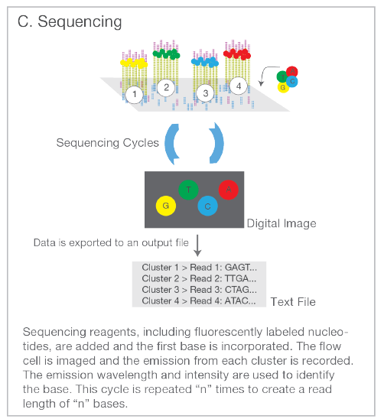

Slide 22
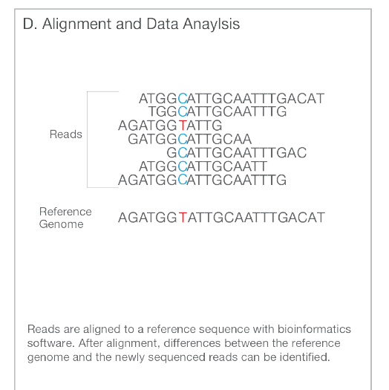

Slide 23
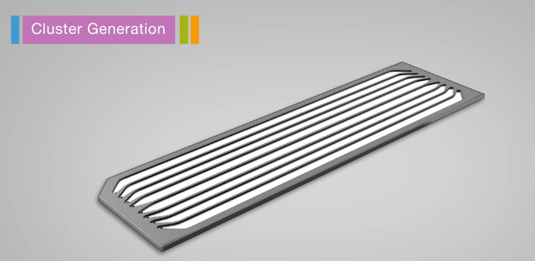
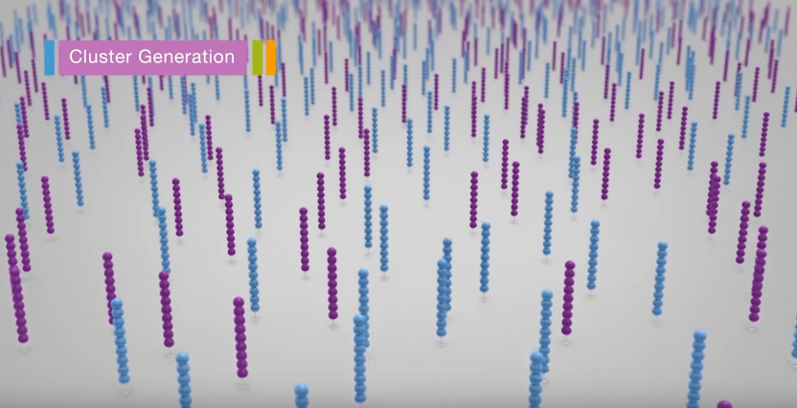
Flow Cell

Slide 24
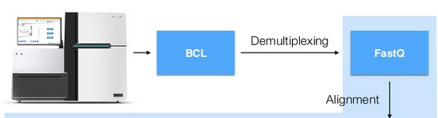
Demultiplexing
Converting images from the sequencer into fastq files

Slide 25
Today’s topics
Checking the quality of the NGS data
Choosing the type of analysis : RNA-Seq
Setting up the pipeline
Analyzing the results

Slide 26
Basic Steps in NGS platforms
https://link.springer.com/chapter/10.1007/978-981-13-8844-6_15

Slide 27
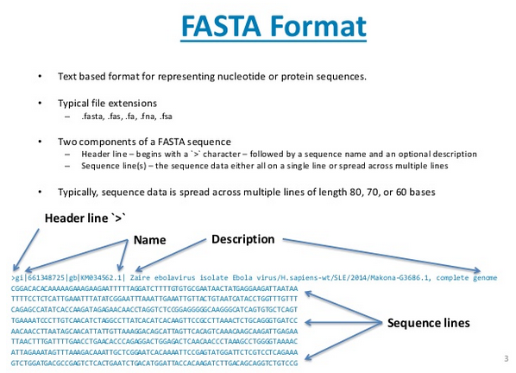

Slide 28
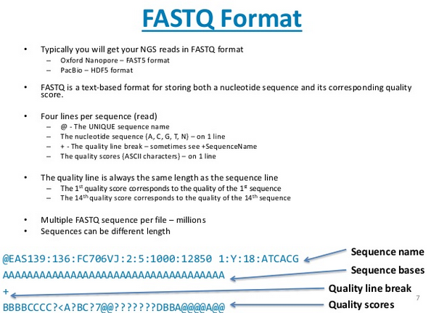
FASTQ

Slide 29
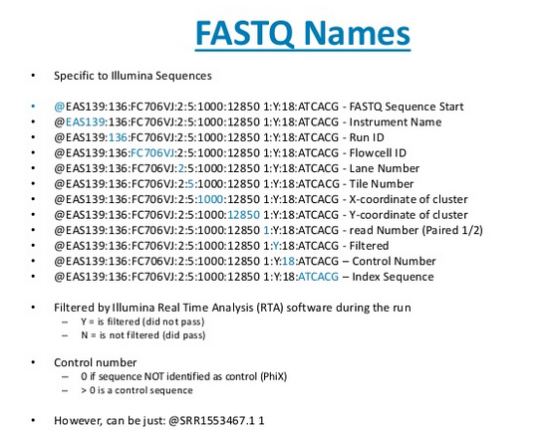

Slide 30
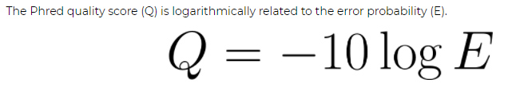
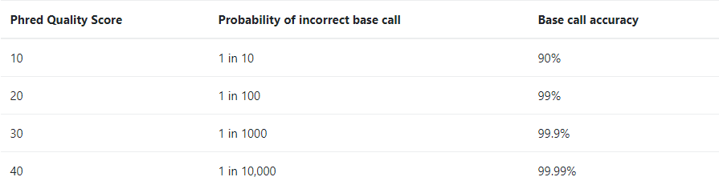
Phred Quality Score - V.I.S.

Slide 31
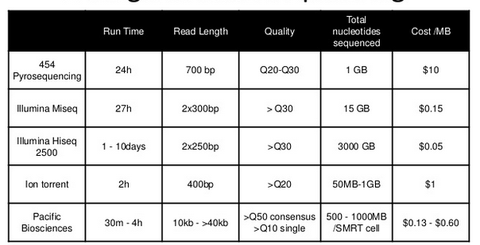
Quality & Comparison
 | doi:10.1155/2012/251364

Slide 32
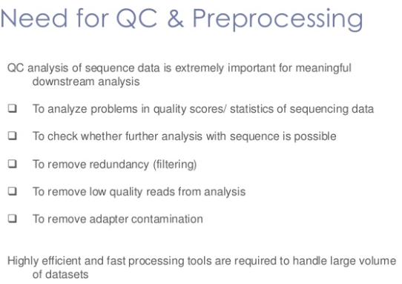

Slide 33
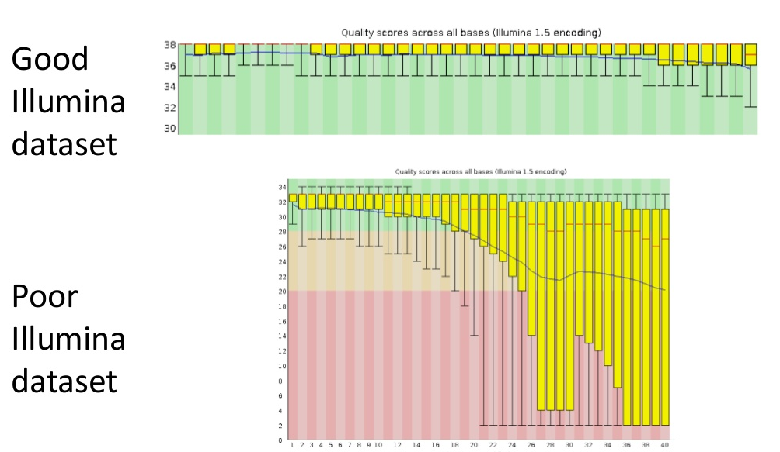
Per base quality

Slide 34
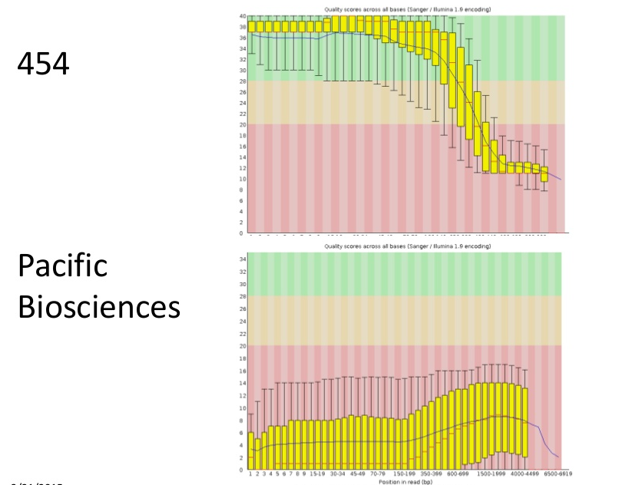
Per base quality

Slide 35
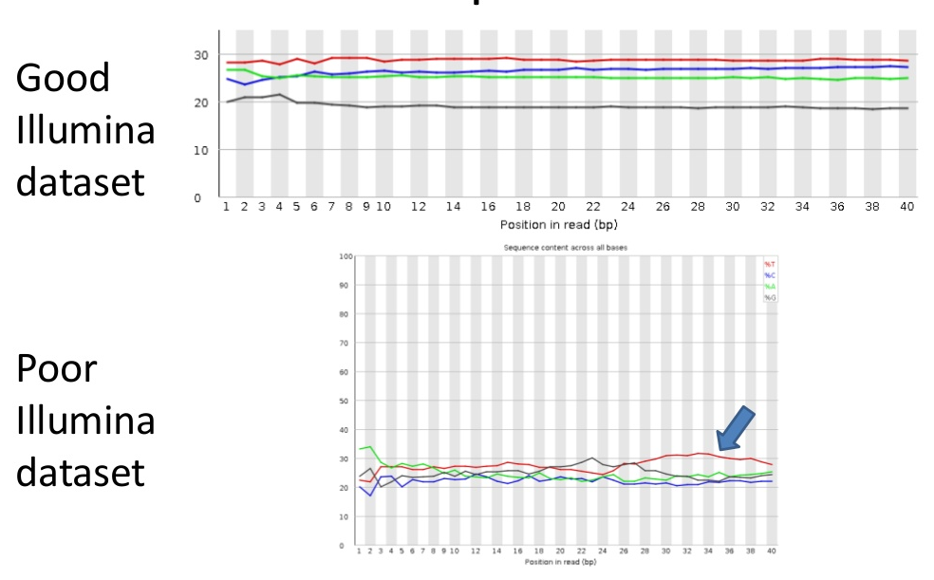
Sequence Content

Slide 36
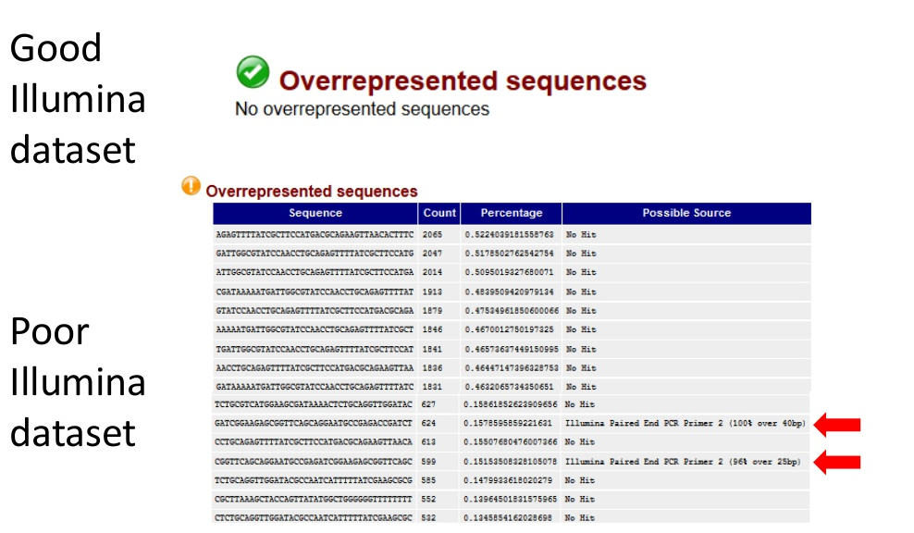
Overrepresented sequences

Slide 37
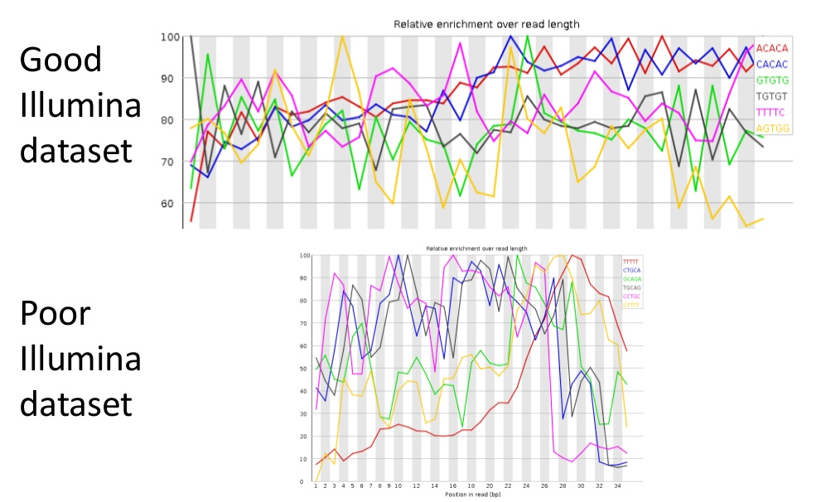
Kmer Content

Slide 38
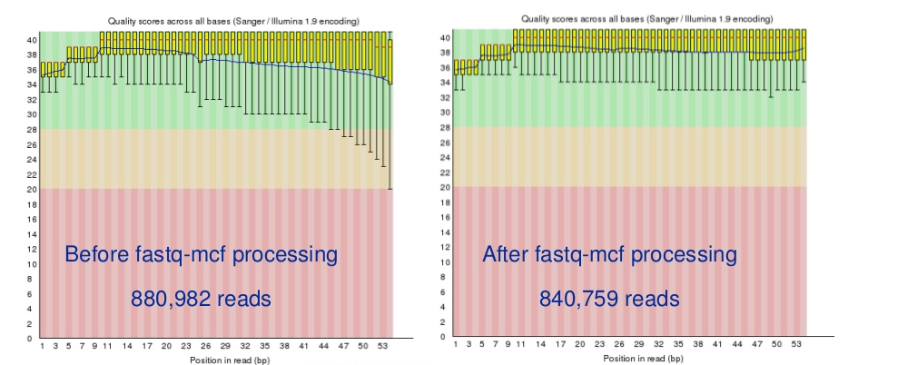
Pre-processing : fastq-mcf Example

Slide 39
So, now we have good quality reads to proceed with!

Slide 40
What are we looking for?

Slide 41

Some target genes?
See any changes/variation in the whole genome?
See any changes/variation only in the protein encoding genome?
Or we need to understand the methylation presence of some genes?
Whether we are looking to quantify the gene expression?
Whether we want to compare samples on the basis of some genes?

Slide 42
Applications V.I.S.
https://www.europeanpharmaceuticalreview.com/article/10409/dna-sequencing-technologies-and-emerging-applications-in-drug-discovery/

Slide 43
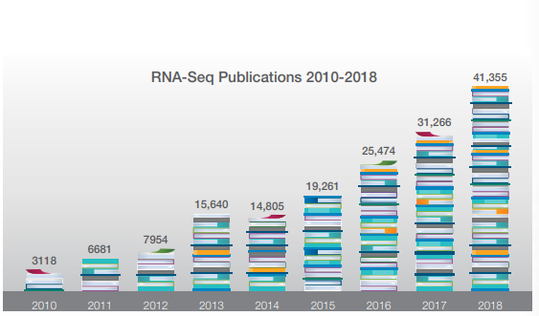

Slide 44
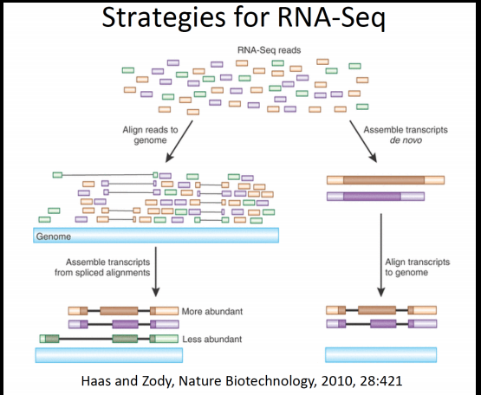
RNA-Seq : Transcriptome Analysis
-----
-----
----
---------
------
-------
-------
---------------------

Slide 45
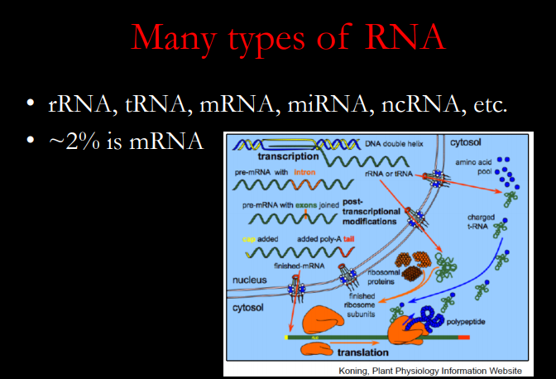

Slide 46
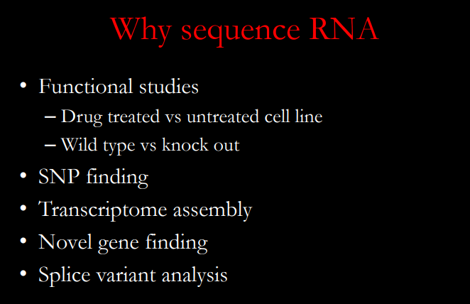

Slide 47
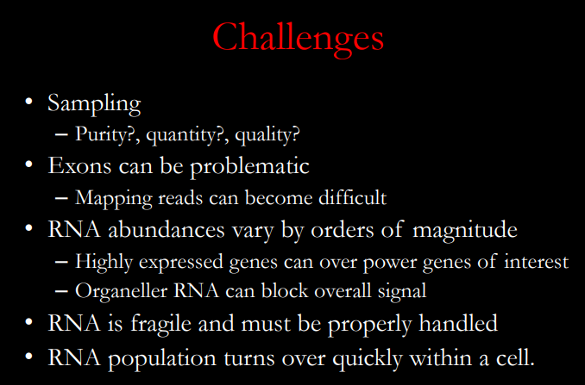

Slide 48
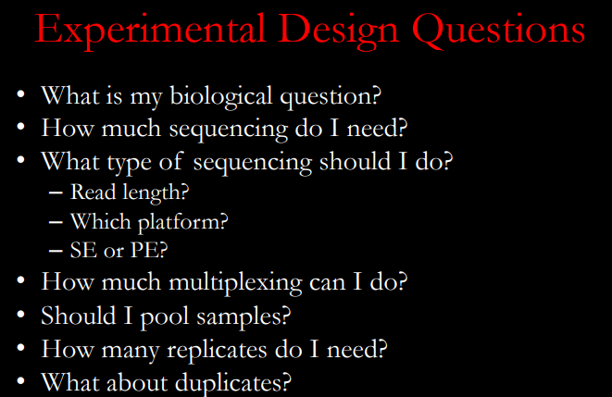
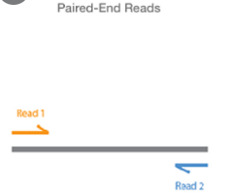

Slide 49
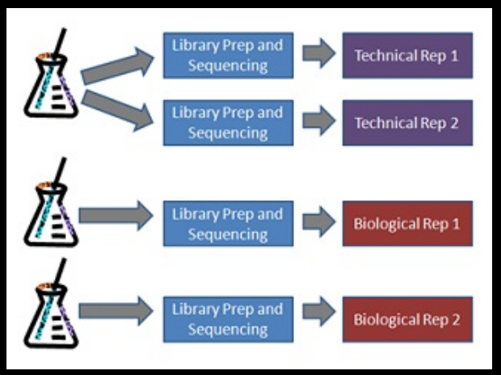

Slide 50
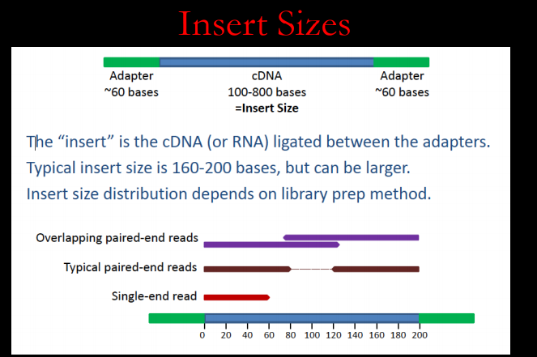

Slide 51
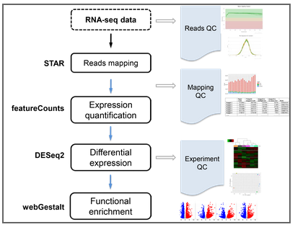
Standard RNA-Seq pipeline

Slide 52
RNA-Seq Steps
Fastq >Adapter Trimming
Contamination removal
Alignment
Expression Estimation/Normalization
Differential Expression
Pathway and Gene Ontology Studies

Slide 53
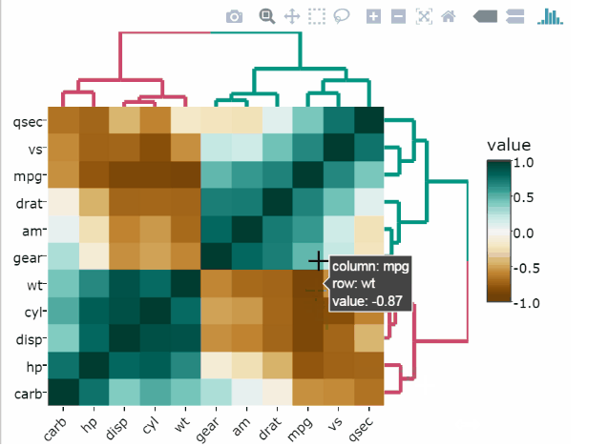
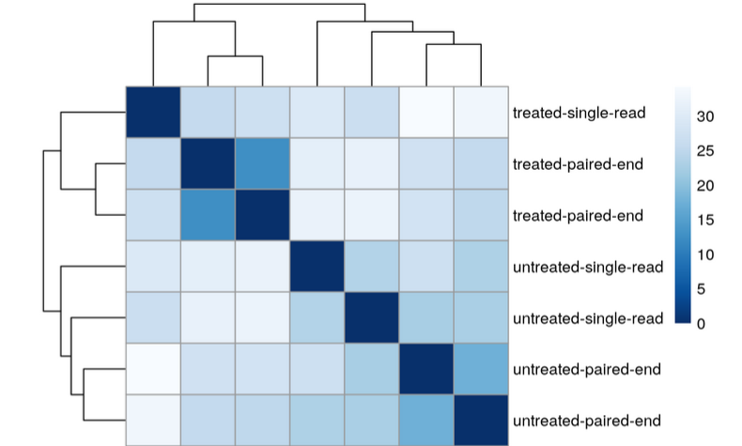
Interactive heatmaps with R packages

Slide 54
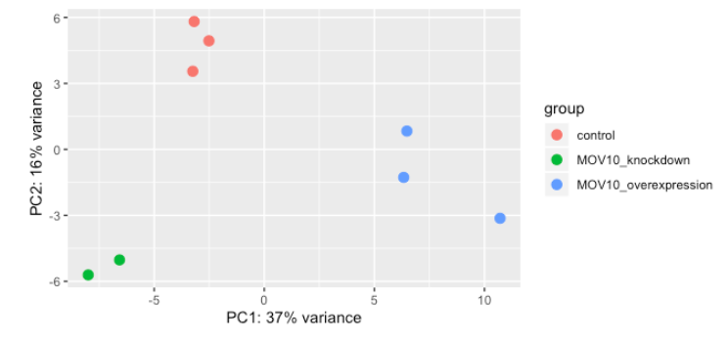
PCA

Slide 55
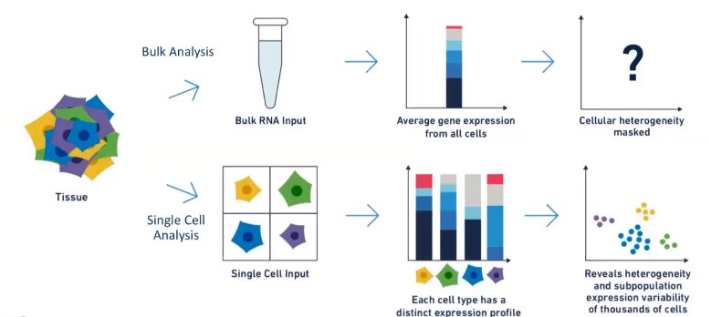
Single Cell Analysis

Slide 56
Applications of Single Cell Analysis
Gene expression studies
Rare Cell Type Detection
Tumor Heterogeneity
Mechanisms of Cellular Differentiation
Novel Biomarker Discovery

Slide 57
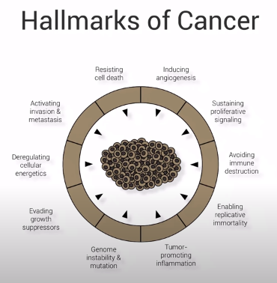
Single Cell and Cancer V.I.S.

Slide 58

Single Cell Analysis vs Bulk Analysis

Slide 59

Multi-omics
https://baiba-vilne-bioinformatician.com/2018/01/28/multi-omics-revolution/

Slide 60
References
https://www.ncbi.nlm.nih.gov/pmc/articles/PMC3841808/
https://www.intechopen.com/books/next-generation-sequencing-advances-applications-and-challenges/next-generation-sequencing-an-overview-of-the-history-tools-and-omic-applications
https://www.genome.gov/about-genomics/fact-sheets/Transcriptome-Fact-Sheet
https://www.ncbi.nlm.nih.gov/pmc/articles/PMC2876223/
https://www.ncbi.nlm.nih.gov/pmc/articles/PMC5136769/

Slide 61
Thank you : )

Slide 62

The second generation
- Sequencing by Synthesis
Ion Torrent
Correct nucleotide is incorporated across from its
complementary base in a growing DNA chain, a hydrogen
ion is released.
Changes the pH of the solution
Voltage change is recorded by an ion sensor much like
a pH meter
If no nucleotide is incorporated, no voltage spike occurs.

